Slide 1

Historia, Aplicaciones y Tendencias de la Investigación de Operaciones
Profesor
Optimización de Operaciones
Escuela de Ingeniería y Ciencias
Tecnológico de Monterrey

Slide 2
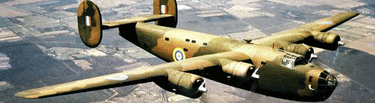
Historia

Slide 3
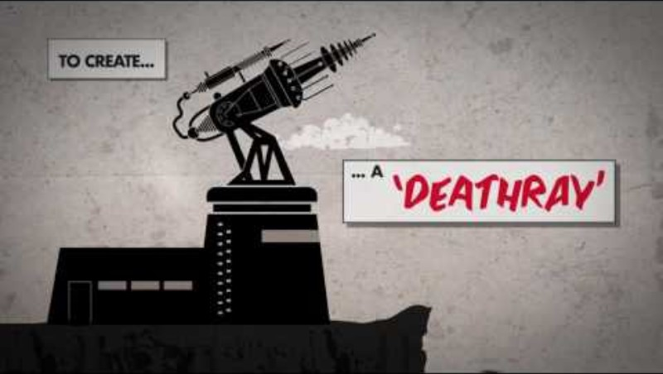

Slide 4
History of OR
Starts in late 1930s in UK just before World War II with the establishment of teams of scientists to study the strategic and tactical problems involved in military operations.
The objective: to find the most effective utilization of limited military resources by the use of quantitative techniques.
After war OR spread in different ways in the UK and USA.
Most OR involves carrying out a large number of numeric calculations. Without computers this would simply not be possible.

Slide 5
History of OR …
Organization of flying maintenance and inspection
Problem: in a squadron each aircraft, in a cycle of approximately 350 flying hours, required in terms of routine maintenance 7 minor inspections (lasting 2 to 5 days each) and a major inspection (lasting 14 days). How then was flying and maintenance to be organized to make best use of squadron resources?
Decision: the current procedure, whereby an aircrew had their own aircraft, and that aircraft was serviced by a devoted ground crew, was inefficient .
Proposal: A central garage system whereby aircraft were sent for maintenance when required and each aircrew drew a (different) aircraft when required.
Outcome: In one trial (over 5 months) the daily operational flying hours were increased by 61% .

Slide 6
History of OR …
Organization of flying maintenance and inspection
Problem: in a squadron each aircraft, in a cycle of approximately 350 flying hours, required in terms of routine maintenance 7 minor inspections (lasting 2 to 5 days each) and a major inspection (lasting 14 days). How then was flying and maintenance to be organized to make best use of squadron resources?
Decision: the current procedure, whereby an aircrew had their own aircraft, and that aircraft was serviced by a devoted ground crew, was inefficient .
Proposal: A central garage system whereby aircraft were sent for maintenance when required and each aircrew drew a (different) aircraft when required.
Outcome: In one trial (over 5 months) the daily operational flying hours were increased by 61% .

Slide 7
History of OR …
Improvement of attack kill probability
(the probability of attacking and killing a U-boat)
Problem: Experience showed that it required some 170 man-hours by maintenance and ground staff to produce one hour of operational flying and more than 200 hours of flying to produce one attack on a surfaced U-boat. Hence over 34,000 man-hours of effort were necessary just to attack a U-boat. In early 1941 the attack kill probability was 2% to 3%. This low attack kill probability is what it really needs to be improved.
Decision: on six variables considered as influencing the kill probability.
Outcome: The overall effect of all the measures was such that by 1945 the attack kill probability had risen to over 40% (remember it started out at 2-3%).

Slide 8

OR Definition
Optimización de Operaciones

Slide 9
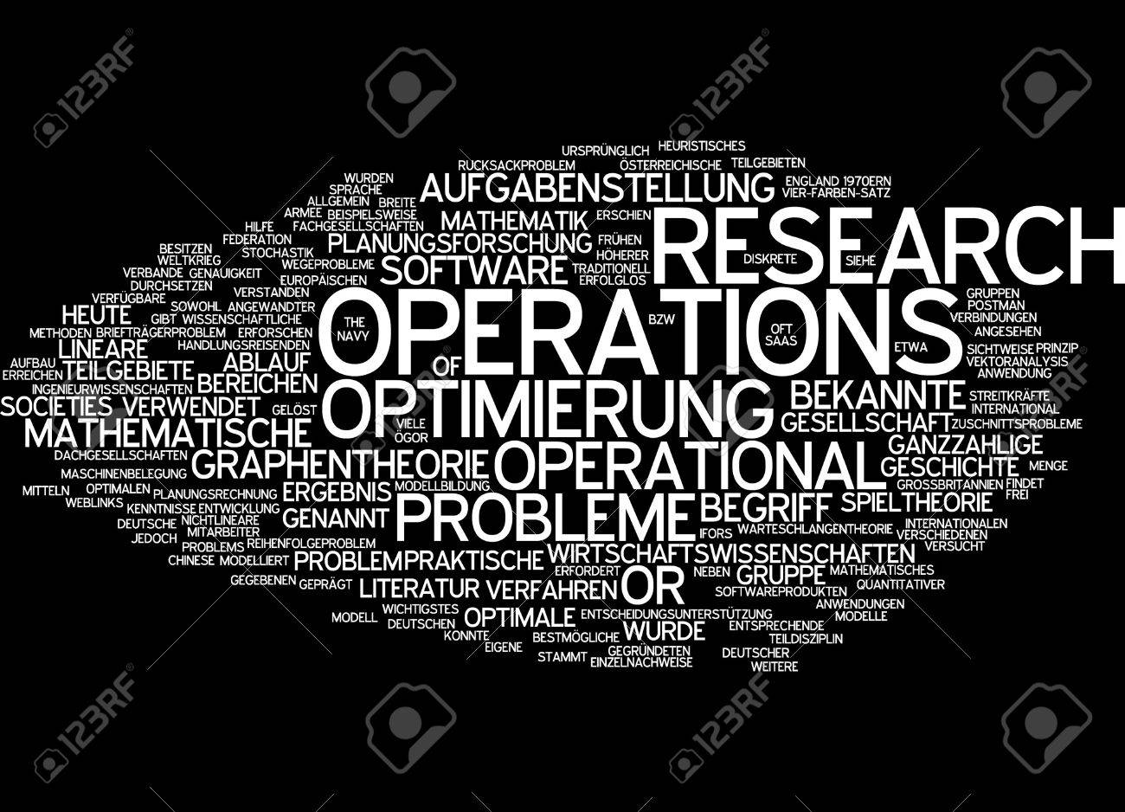
OR Definition
OR is the discipline of applying advanced analytical methods to help make better decisions.
By using techniques such as mathematical modeling to analyze complex situations, OR gives executives the power to make more effective decisions and build more productive systems based on:
More complete data
Consideration of all available options
Careful predictions of outcomes and estimates of risk
The latest decision tools and techniques
(the Science of Better)

Slide 10
Other OR Definition
OR is the application of the scientific method, by interdisciplinary teams, to problems related to the management and control of organizations or systems in order to produce solutions that help to reach the organization objectives.
Organizational vision
Gives conclusions to the decision maker
Extense application: manufacturing, transportation, health, army, etc.

Slide 11
One more …
Interdisciplinary branch of mathematics which uses methods like mathematical modeling, statistics, and algorithms to arrive at optimal or good decisions in complex problems which are concerned with optimizing.
the maxima (profit, faster assembly line, greater crop yield, higher bandwidth, etc) or
The minima (cost loss, lowering of risk, etc) of some objective function.

Slide 12

Aplicaciones

Slide 13
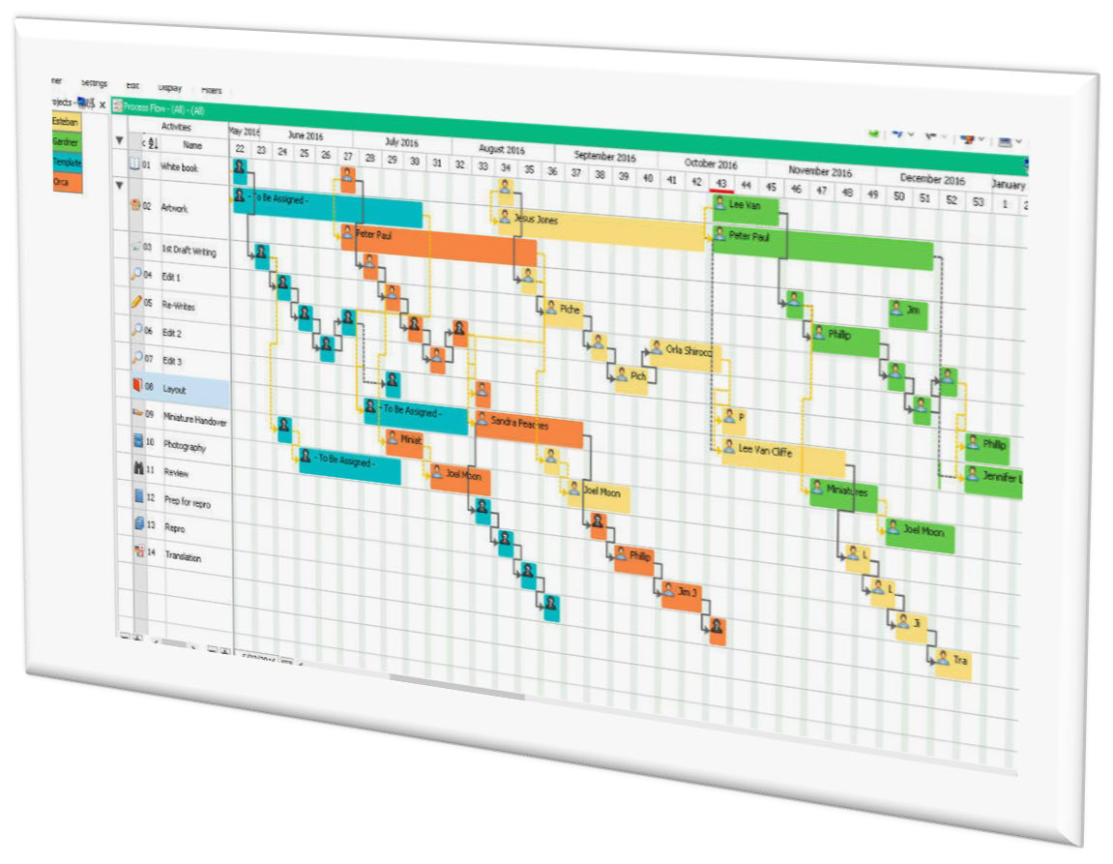
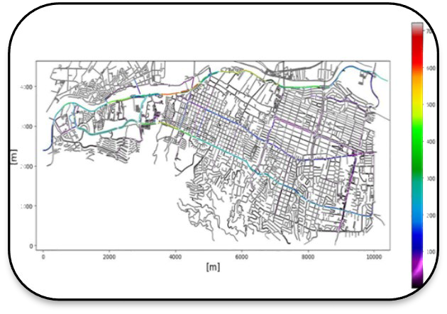

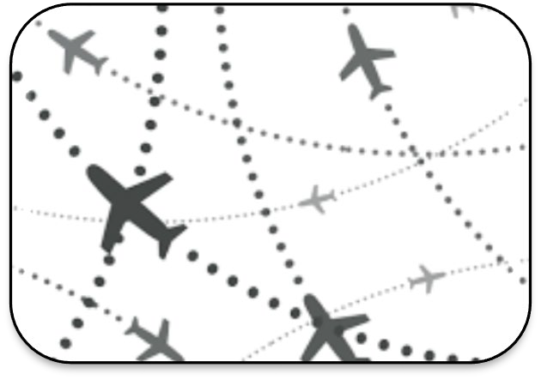
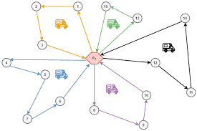


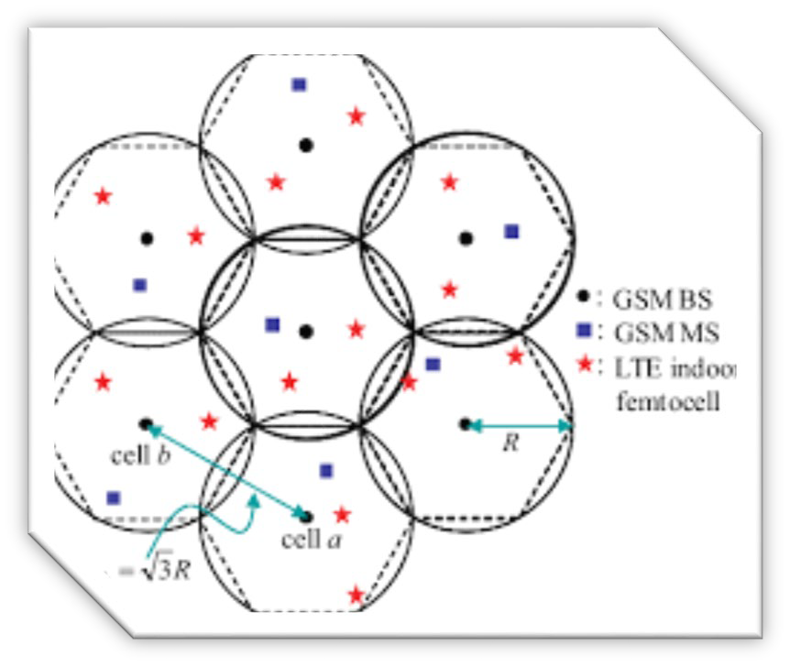
OR Applications
Ruteo y programación de tripulaciones de aviones integrado
Programación y secuenciación
Microsimulación de tráfico
Ruteo de vehículos para distribución
Distribución de almacenes
Distribución de última milla
Ruteo interunivesitario
Localización de instalaciones: e.g., antenas parabólicas

Slide 14
Industrial problems
Inventory supply model for perishable products: Calicarnes case. Mesias, Ivan D., Osorio, Fernando A., Díaz, J. (2017). International Symposium on IEOM, Bogota, Colombia, October 25-26, 2017. First place award - Undergraduate paper competition.
Decrease in loading times for trucks at a steel company. Ortega, A., Cantú, A., Solís, M., Días, J. (2019). International Conference on IEOM, Bangkok, Tailandia, March, 2019.
A Vehicle Routing Problem with Most-Expensive-Customer Dependent Costs. Cárdenas de la Fuente, G., García-Martínez, Gloria C., Alejandro-Ugarte, Francisco, Díaz-Ramírez, J. (2021). Accepted in the 11th Annual International Conference of IEOM. Singapore, Mar 9-11, 2021.
Incorporation and Design of a New Facility in a Country-wide Logistics Network. Ricaño, Oscar E., Lozano, Héctor A., Moreno, José C., Díaz-Ramírez, J. (2020), Proceedings of the 2nd African IEOM Conference in Harare, Zimbabwe, December 7-10, 2020.
A unified model framework for the multi-attribute consistent periodic vehicle routing problem
Baldoquin MG, Martinez JA, Dıaz-Ramırez, J. (2020) A unified model framework for the multi-attribute consistent periodic vehicle routing problem. PLoS ONE 15(8): e0237014.

Slide 15
Caso Práctico
Aerolíneas: ruteo de aviones y programación de tripulación
Programación del torneo de eliminatorias al mundial de futbol
Programación de producción de polioles
Determinación de tamaño de lote en comercializadora carnícola.
Ruteo universitario UDEM

Slide 16

Tendencias

Slide 17
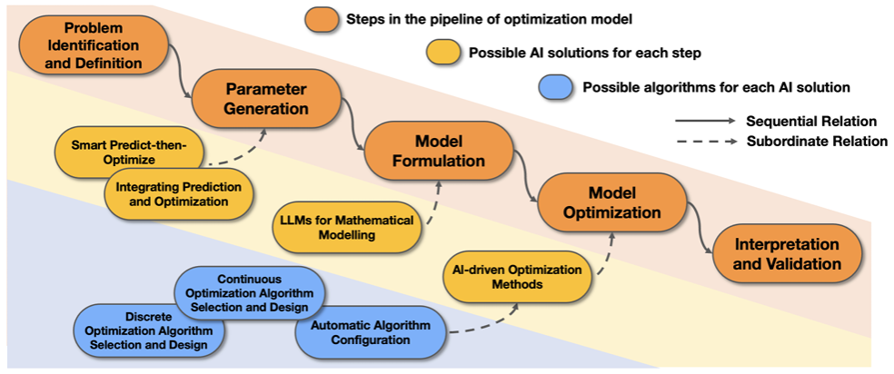
Tendencias
Integración con la IA
Optimización computacional en paralelo
Fan, Z., Ghaddar, B., Wang, X., Xing, L., Zhang, Y., & Zhou, Z. (2024). Artificial Intelligence for Operations Research: Revolutionizing the Operations Research Process.
Desarrollo de algoritmos en paralelo, optimización híbrida, etc.
Métodos Heurísticos y Metaheurísticos
Aplicaciones en campos emergentes
Avances en optimización combinatoria
Sistemas autónomos, ciudades inteligentes, gemelos digitales, y otros sistemas complejos.
Notes:
Smart grids…

